Slide 1

Hands-On Heat Tutorial
Brought to you by Rackspace and SUSE
Insert Presenter's Name (16pt)
Insert Presenter's Title (14pt)
Insert Company/Email (14pt)
Insert Presenter's Name (16pt)
Insert Presenter's Title (14pt)
Insert Company/Email (14pt)

Slide 2
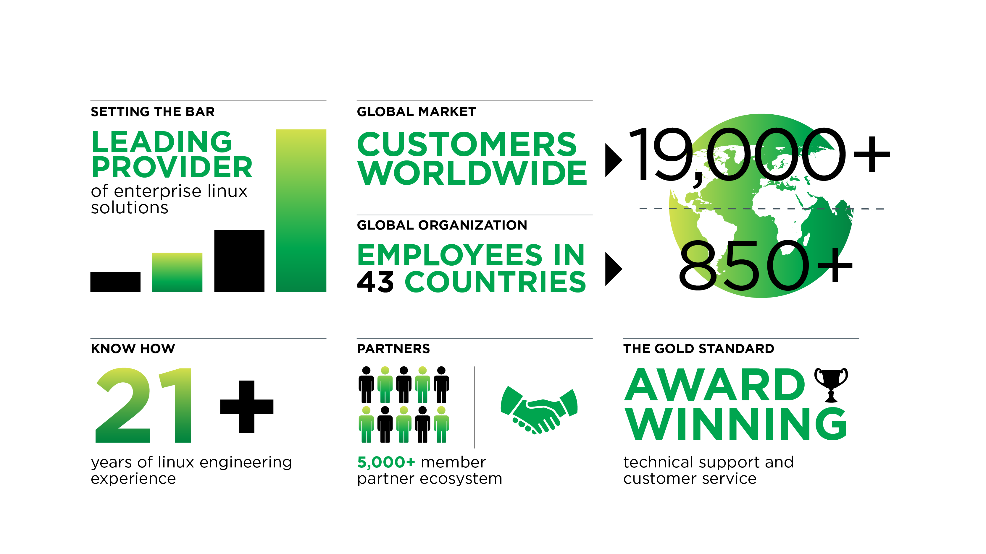
21 Years of Adapting Open Source
Notes:
SUSE is a leading provider of Linux-based solutions for the enterprise
Over 13,000 customers today are supported by a global organization - over 700 employees in 43 countries
We are not new to the Linux market. As an organization, SUSE has been commercializing open source software for over 20 years
What we are known for (and proud of) is our extensive partner and ISV ecosystem, and the award-winning support we consistently provide to our customers.

Slide 3


How is SUSE Participating?
Platinum Member
Alan Clark
Chairman of the Board
Technical
Contributions
OpenStack
Distribution
Promotion in
openSUSE Community
Notes:
SUSE is an original platinum member of the OpenStack foundation. As such, we provide legal, engineering, and ongoing financial support to the foundation.
Alan Clark, who also sits on the board of the Linux Foundation, is the Chairman of the OpenStack Foundation's board. His experience working on behalf of SUSE within other Open Source communities proved invaluable during the formation of the foundation. His colleagues recognized this and voted him as chairman.
SUSE has focused its technical contributions to date on making sure OpenStack is enterprise ready.
Security and hardening of the code.
Easing deployments and ongoing maintenance
Ensuring multi-hypervisor support by upgrading OpenStack support for Xen and working with MSFT to ensure full support for Hyper-V.
We will continue to provide code and feature contributions in future releases.
Ultimately all of this is to ensure that we have the most enterprise ready OpenStack distribution

Slide 4
Rackspace Intro

Slide 5
Service Deployment

Slide 6



How do I deploy it?
There are 3 ways to deploy services in the cloud:
The easy way
The “not quite as easy” way
The “hard up-front, but totally
easier in the end” way

Slide 7

How do I deploy it?
The easy way ...
Manual deployment process
  Log into the dashboard
  Go to the images section
  Select your image(s) and launch it
  Configure networking and storage as necessary
Very quick and easy...
If you're doing it once

Slide 8




How do I deploy it?
The “not quite as easy” way ...
Use the API
  Python libraries
  Script out the manipulation of compute, network, and storage
Labor intensive up front, but scales easily to
large deployments
Not terribly friendly to all potential cloud users

Slide 9


How do I deploy it?
The “hard up-front, but totally easier in the end” way
OpenStack Heat Project
  Incubated project for Grizzly
  Fully supported as of SUSE Cloud 3.0 (Havana)
Heat is a service to orchestrate multiple
composite cloud applications

Slide 10
How do I deploy it?
The “hard up-front, but totally easier in the end” way
“Heat is a service to orchestrate multiple
composite cloud applications using the AWS
Cloud Formation template format, through
both an OpenStack-native ReST API and a
CloudFormation-compatible Query API.”

Slide 11

How do I deploy it?
The “hard up-front, but totally easier in the end” way
“Heat is a service to orchestrate multiple
composite cloud applications using the AWS
Cloud Formation template format, through
both an OpenStack-native ReST API and a
CloudFormation-compatible Query API.”
Um ... what?

Slide 12
How do I deploy it?
The “hard up-front, but totally easier in the end” way
Heat allows you to pre-define a set of compute, network, and storage requirements to provide a specific service, and deploy the whole thing automagically.

Slide 13
It's hands-on time!
<url for cloud instance>
<url for heat template>
Notes:
Demo of UI etc...

Slide 14


Slide 15
Title of No-Logo Slide Here (32pt)
First-level bullet (24pt)
  Second-level bullet (20 pt)
    Third-level bullet (16pt)
      Fourth-level bullet (14pt)

Slide 16
Title of Logo Slide Here (32pt)
Subtitle Here (20pt)
First-level bullet (24pt)
  Second-level bullet (20 pt)
    Third-level bullet (16pt)
      Fourth-level bullet (14pt)

Slide 17
Section Break Text Here (32pt)

Slide 18
Call to action line one
and call to action line two
www.calltoaction.com

